Slide 1
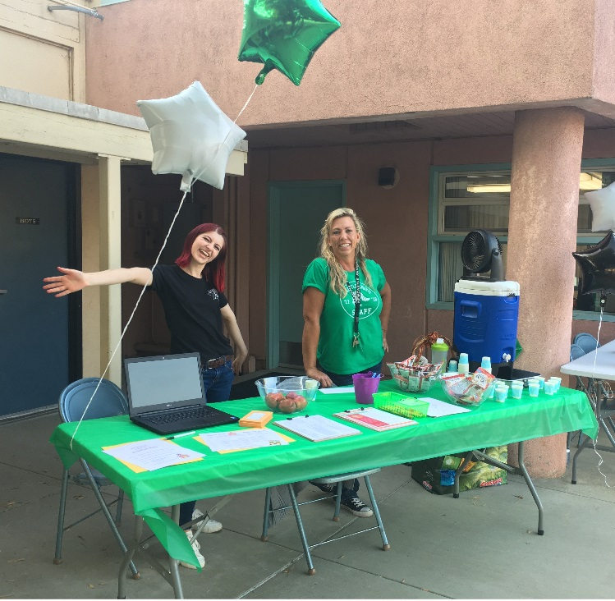
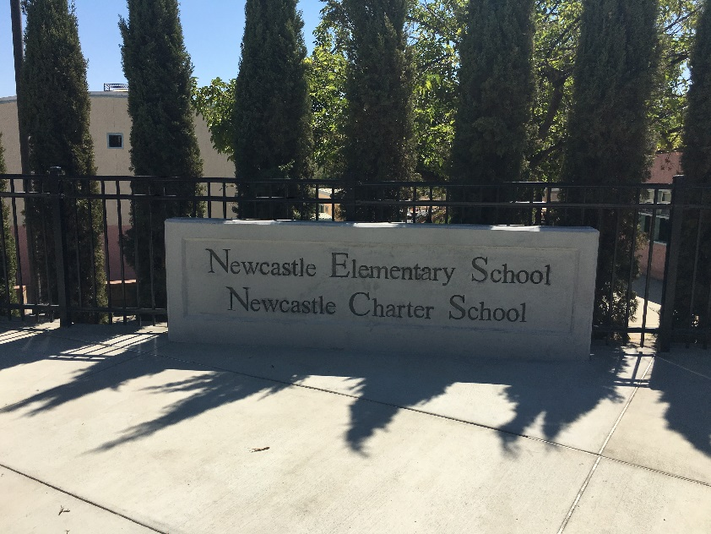
Newcastle Elementary School District
2016/2017 Unaudited Actuals

Slide 2
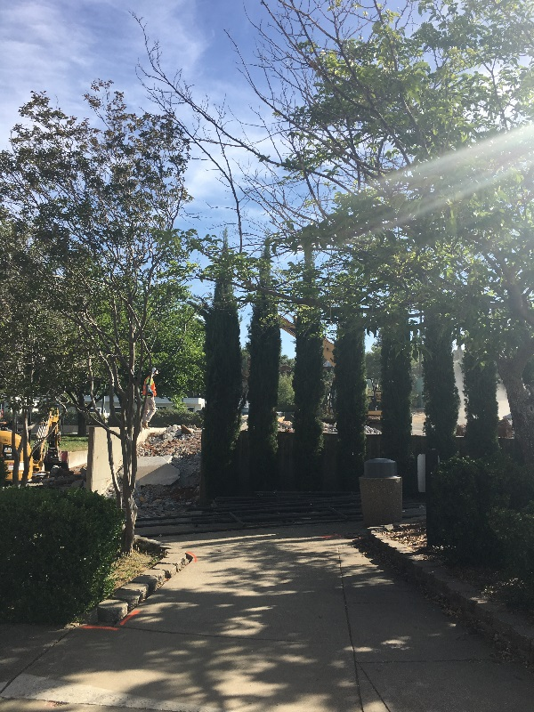
2016/2017
Unaudited Actuals
Fund Overview
2016/2017 Budget Components
EPA
NES/NCS
Revenue and Expenses
School District Basic Aid Supplement Charter School Funding
Change in Ending Fund Balance
EFB Assignments
Harvest Ridge/Placer Academy
Revenue
Expenses
Change in Ending Fund Balance
EFB Assignments
Long Term Debt
Other Funds
Ending Fund Balance Assignments

Slide 3
District Funds- Overview
Fund 01 = General Fund (District & NES)
Fund 09:
  Newcastle Charter (Internal Fund Code of 09)
  Harvest Ridge Charter (Internal Fund Code of 04)
Fund 13 = Food Service
Fund 14 = Deferred Maintenance
Fund 25 = Capital Facilities/Developer Fees
Fund 40 =Capital Outlay

Slide 4
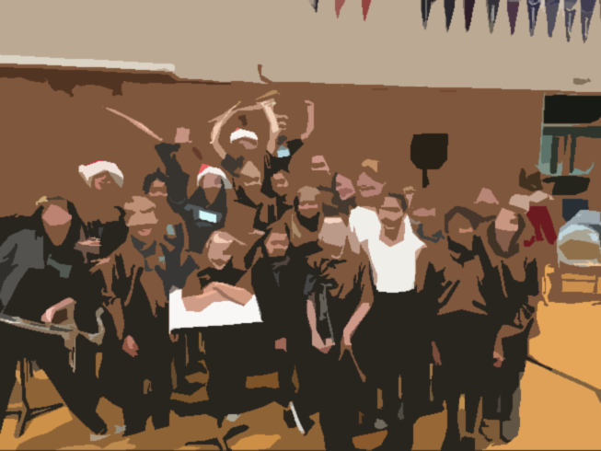
2016/2017
Where we ended up……
2016/2017 P-2 ADA
Newcastle 141
Elementary
Newcastle 289
Charter
Harvest Ridge 472
Total 902
Per ADA Amounts
Unrestricted Lottery $143
Restricted Lottery $45
Mandated Costs Block Grant
Elementary School $28
Charter School $14
One Time Mandated Cost $214
NES/NCS Band

Slide 5
Education Protection Act (EPA) Funding
Fund | Beginning Balance | Revenue | Expenses | Ending Balance
Newcastle Elementary | 0 | 177,334 | 175,806 | 1,528
Newcastle Charter School | 0 | 375,228 | 372,340 | 2,888
Harvest Ridge Placer Academy | 0 | 608,967 | 604,471 | 4,496
EPA funding is a sub-group of the State Aid calculation process and stems from the passage of Prop 30 back in 2012. It is not add-on revenue, but instead is deducted from total State Aid due (less local property taxes) and assigned a separate resource (1400) for tracking purposes by the State. This portion of State Aid, designated as EPA funding, is budgeted for certificated teacher salaries for all school sites and charter schools to stay in compliance with Prop 30 requirements.
On November 8, 2016, the voters approved the California Children’s Education and Health Care Protection Act (Proposition 55) that maintains increased personal income tax rates for taxpayers in high tax brackets through 2030. Proposition 55 did not extend the sales tax increase; therefore, the temporary sales tax increase expired at the end of calendar year 2016.

Slide 6
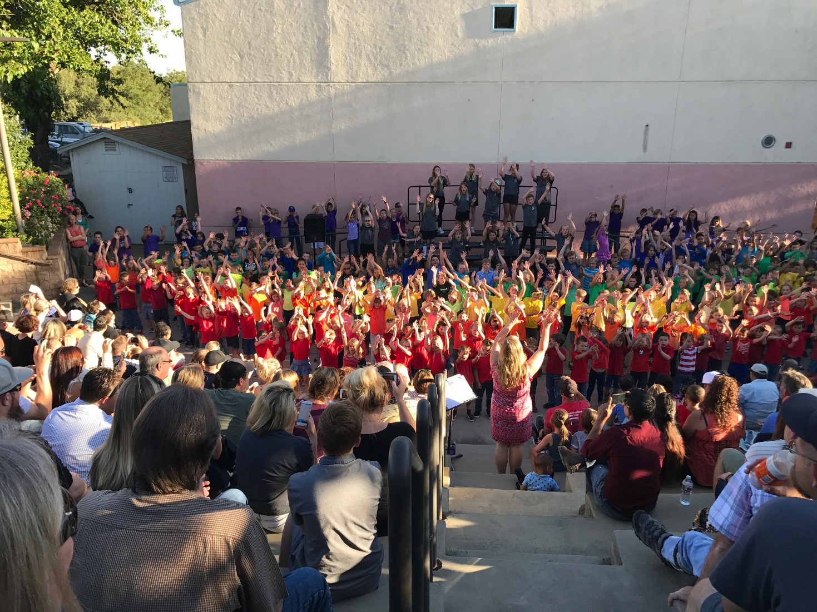
Newcastle Elementary/Newcastle Charter School
2016/2017 Open House Performance

Slide 7
Newcastle Elementary/Charter School
Unrestricted & Restricted Revenue as of June 30, 2017
Unrestricted/ Restricted Revenue | NES | NCS | Total | Notes
LCFF Revenue Supplemental Funding | *6,198,722 | 2,168,987 | 8,367,709 | NES Includes Basic Aid Supplemental Funding
Federal Revenue | 122,344 | 0 | 122,344 | Title l & II Fed Spec Ed
State Revenue | 304,954 | 410,077 | 715,031 | Lottery Mandated Costs *STRS on Behalf
Local Revenue | 241,835 | 6,020 | 247,855 | Interest Oversight Fees SELPA Revenue
Total | 6,867,855 | 2,585,084 | 9,452,939
*Supplemental Funding = 4,697,228 LCFF Funding= 1,501,494

Slide 8
What is the Basic Aid Supplement Funding?
CDE Definition- School District Basic Aid Supplement Charter School Adjustment
Current year state aid to backfill a school district for the loss of local revenue to a charter school serving nonresident students.
LCFF Exhibit Reference Guide
Basic Aid Supplement funding provides state aid for sponsoring school districts up to 70 percent of the LCFF entitlement of the pupil’s school district of residence.
Education Code Section 47663
Total Charter School ADA
2,095
Newcastle Elementary ADA
141
P-2 ADA
NES 141
NCS 290
HRCC 473
SVP 27
Creekside 133
RA Gateway 1,172
Total 2,236

Slide 9
Unrestricted/ Restricted Expenses | NES | NCS | Total | Notes
Certificated Salaries | 1,310,370 | 805,404 | 2,115,774
Classified Salaries | 611,153 | 98,773 | 709,926
Benefits | 548,385 | 378,039 | 926,424 | Includes STRS on Behalf
Books and Supplies | 154,936 | 99,693 | 254,629
Other Services Operating Exp. | (216,051) | 711,205 | 495,154
Capital Outlay | 713,964 | 12,627 | 726,591 | Prop 39 Energy Efficiency Projects
Other Outgo | 67,510 | 95,870 | 163,380 | Debt Payments Contr to Other Funds
Total | 3,190,267 | 2,201,611 | 5,391,878
2016/2017 NES/NCS Expenditures as of June 30, 2017
Restricted and Unrestricted
Salaries and Benefits represent 81% of total expenses
(Excluding Capital Outlay)

Slide 10
Newcastle Elementary/Charter School
2016/2017 Revenue and Expenses

Slide 11
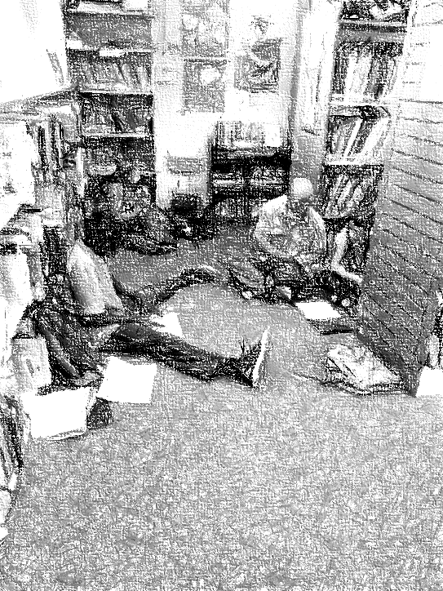
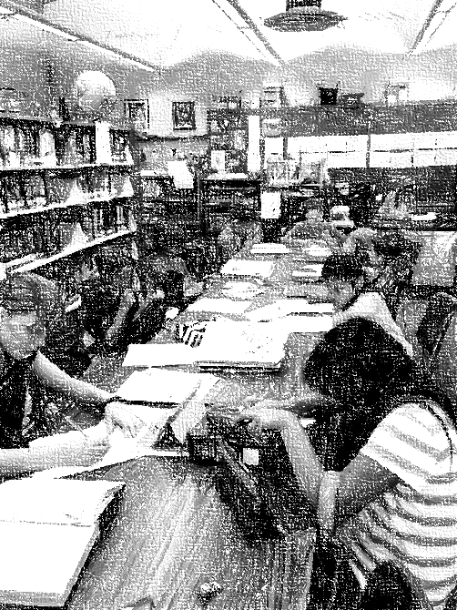
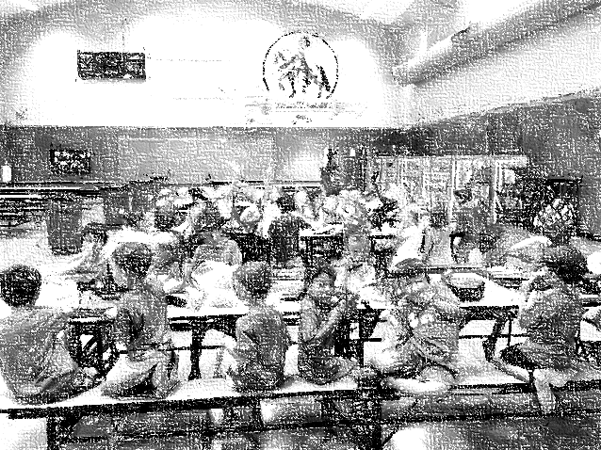
Contributions to other funds;
Special Education 188,298
Restricted Routine Maintenance 91,751
Total 280,049
2016/2017 Unaudited Actuals

Slide 12
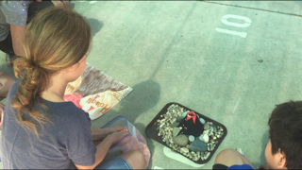
2016/2017 Unaudited Actuals
Components of Ending Fund Balance
Unrestricted & Restricted Funds
Components of EFB | NES Fund 01 | NCS Fund 09
Reserve for Economic Uncertainty | 958,490
Restricted | 507,314 | 162,881
Prepaid | 27,392 | 16,585
Committed to Long Term Debt | 224,344
Awning Project | 7,650
Library Funds Book Fair+General Funds | 6,100
Stem Donations | 230
Music Program | 203
Revolving Cash | 700
EPA-Cert Salaries | 1,528 | 2,888
Lottery- Cert Salaries | 6,693
Classroom Tech/Student Programs | 328,122
Unassigned |  | 285,666
Total | 2,068,766 | 468,020
 | NES | NCS | Total
Beginning Fund Balance | 2,903,625 | 130,100 | 3,033,725
Change | (834,859) | 337,920 | (469,939)
Ending Fund Balance | 2,068,766 | 468,020 | 2,563,786

Slide 13


Slide 14

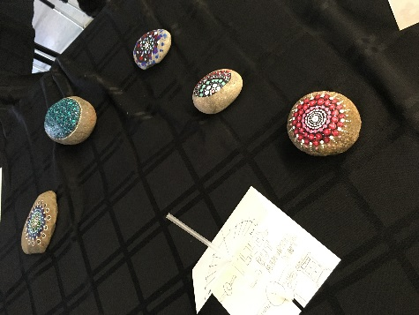
Harvest Ridge/Placer Academy Revenue
Unrestricted & Restricted Revenue as of June 30, 2017
Revenue | Unrestricted | Restricted | Total | Notes
LCFF Revenue | 3,537,651 | 0 | 3,537,651 | General Purpose
State Revenue | 170,591 | 96,786 | 267,374 | Lottery Mandated Costs
Local Revenue | 15,916 | 0 | 15,916 | Interest Donations
Total | 3,724,158 | 96,783 | 3,820,941

Slide 15
2016/2017 Harvest Ridge/Placer Academy Expenditures
As of June 30, 2017
 | Unrestricted | Restricted | Total | Notes
Certificated Salaries | 1,678,934 | 0 | 1,678,934
Classified Salaries | 242,831 | 28,441 | 271,272
Benefits | 460,112 | 6,337 | 466,449
Books and Supplies | 345,107 | 37,781 | 382,888
Other Services Operating Exp. | 886,849 | 19,215 | 906,064 | Includes rent on Placer Academy, Maintenance, Contracted Services
Capital Outlay | 0 | 3,625 | 3,625 | CA Clean Energy
Total | 3,613,833 | 95,399 | 3,709,232
Salary and Benefits are 65% of total Expenses

Slide 16
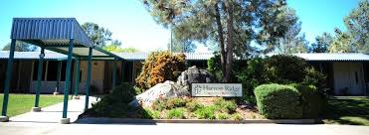
Components of Ending Fund Balance as of June 30, 2017
Harvest Ridge/Placer Academy
Fund Balance
Beginning Fund Balance | 769,905
Est Net Change | 59,709
Ending Fund Balance | 829,614
Components of EFB
Prepaid | 28,382
Lottery – Certificated Salaries | 21,117
EPA – Certificated Salaries | 4,496
*Legally Restricted Balances | 99,916
Reserve for Economic Uncertainties-5% | 185,462
Unassigned | 490,241
Total of Components | 829,614
*Legally Restricted Includes: Spec Ed Funding, CA Clean Energy, Lottery

Slide 17

Newcastle Elementary School District
Final Facts…….

Slide 18
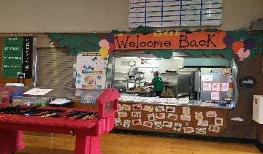
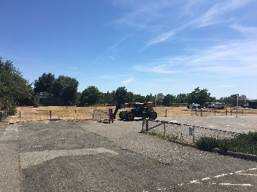
Fund | Beginning Fund Balance | Est. Net Change | Ending Fund Balance
Other Funds
Changes to Ending Fund Balance
Food Service | 32,759 | 7,158 | 39,917
Deferred Maintenance | 1,200,000 | (901,993) | 298,007
Capital Facilities | 30,567 | (19,225) | 11,343 | Dev Fees and Portable Payments
Capital Outlay | 1,500,000 | 8,159,968 | 9,659,968 | See EFB Assignment

Slide 19
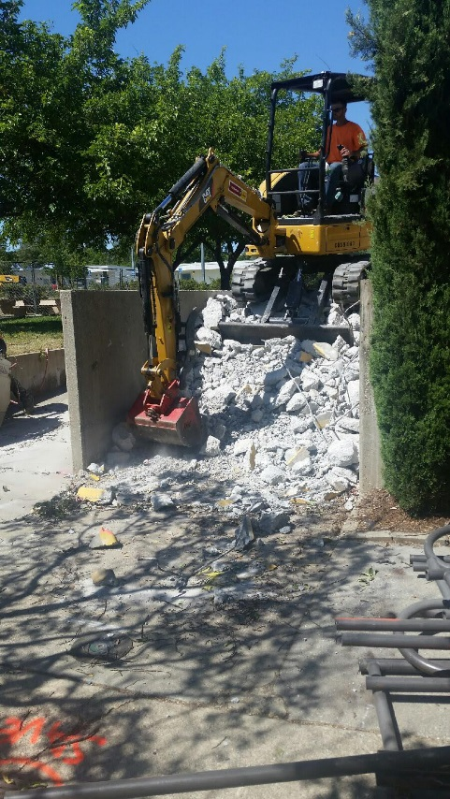
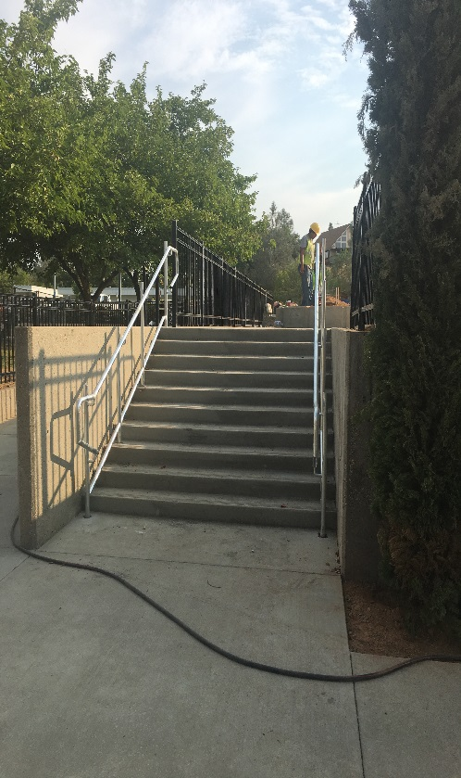
Components of Ending Fund Balance as of June 30, 2017
Capital Outlay
Components of EFB
Property Acquisition
Building Improvements
Phase I
Staircase/Ramp
Phase II
Total
3,500,000
500,000
2,300,000
851,000
2,508,968
9,659,968

Slide 20
Newcastle Elementary School District Long Term Debt
 | Balance | 2016/2017 Payment Principal & Int | Duration
Apple Lease | 177,644 | 91,362 | Annually until 10/2017
New Portable – NES/NCS | 46,438 | 16,501 | Annually until 7/12/2018
SWS Loan – Facility Repairs | 508,820 | 49,624 | Paid in two annual payments until 10/1/2029
Capitol One-Energy Efficiency Supplement | 759,984 | 18,553 | Paid in two annual payments until 4/1/2033
Classroom Portable From PCOE | 8,200 | 8,200 | Annually until 2017
OPEB (Other Post Employment Benefits) | 36,336 | 9,084 | Could increase with additional retirements
Total | 1,537,422 | 193,324

Slide 21
Multi Year NESD Long Term Debt
Annual Payments
 | 2016/2017 | 2017/2018 | 2018/2019
Apple Lease | 91,362 | 91,362* | 0
New Portable – NES/NCS | 16,501 | 16,501 | 16,501
SWS Loan – Facility Repairs | 49,624 | 49,624 | 49,627
Capital One – Energy Efficiency Supplement | 18,553 | 68,155 | 46,149
Placer County Treasury | 0 | 148,471 | 148,471
Classroom Portable From PCOE | 8,200 | 0 | 0
OPEB (Other Post Employment Benefits) | 9,084 | 9,084 | 9,084
Total | 193,324 | 383,197 | 269,832

Slide 22
Conclusion and Overview
2016/2017
Added .6 FTE Band/Music Teacher and brought music into the school day
Incorporated Noon Duty, Crossing Guards, and Flex Aides into Classified Student Support Aides- (Good for staff and students)
Additional .4 FTE Resource Teacher
Added 6 Hour Special Education Aide
Proposition 39 – Water and Light Energy Efficiency Projects in Place (already seeing savings)
English Language Arts Text Book Adoption-Bench Mark and Spring Board
3% Salary Increase For All Staff Plus 1% on Health Benefit Cap
Offered Free Bus to All Students
Added 1 hour Cafeteria Assistant (increased to 3.5 in 17/18 due to success)
Identified Contractors, Consultants, and Went to Bid for Phase 1 Projects
Negotiated Purchase of Additional Campus with PCOE
2016/2017 Unaudited Actuals
9/13/2017

Slide 23
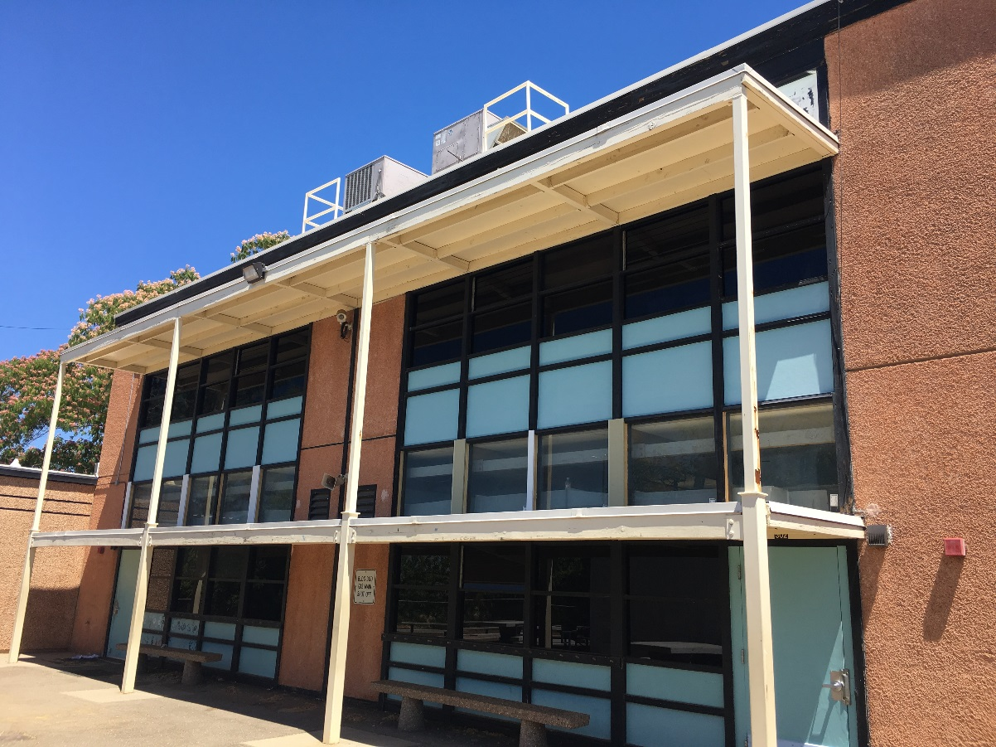
Any Questions
Thank you!

